Slide 1
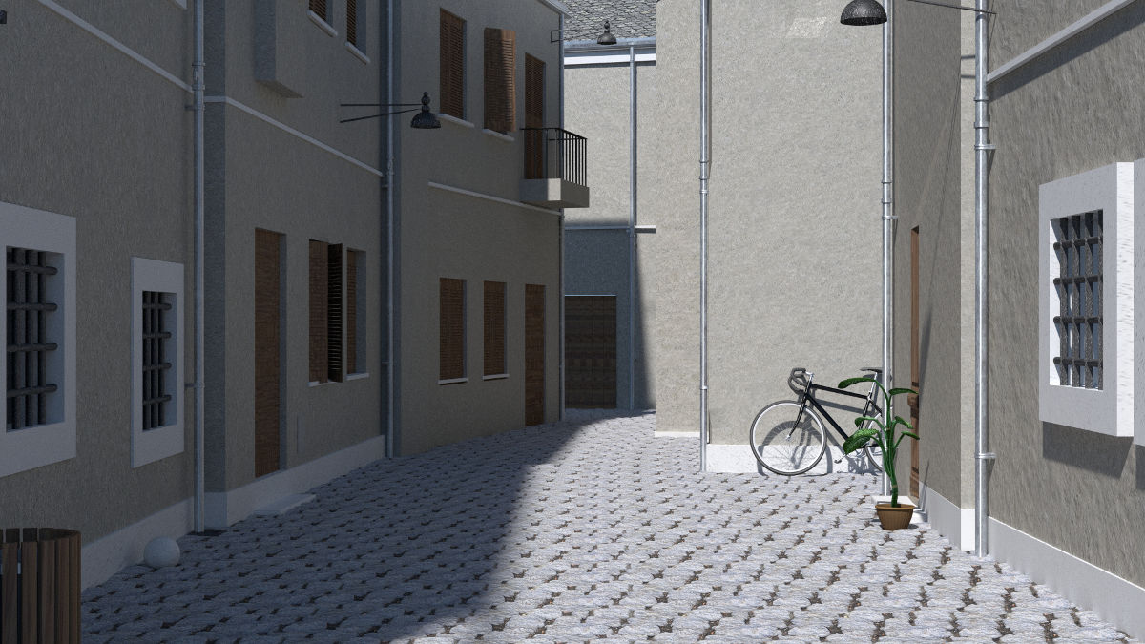
Video game task
During this task, as in a video game, you will be in an environment in which you will be able to move forward or backward. The environment in which you will be able to move is presented below:
Press SPACE to continue

Slide 2
A series of words will be displayed in this environment and your task will be to move forward or backward as function of these words (more specific instructions following).
You will be able to move in the environment by using the following keys of the keyboard:
Y = to MOVE FORWARD
H = START key
N = to MOVE BACKWARD
Press SPACE to continue

Slide 3
At the beginning of each trial, you will see the O symbol. This symbol indicates that you have to press the START key (namely the H key) to start the trial.
Then, you will see a fixation cross (+) in the center of the screen followed by a word.
Your task is to move forward or backward by pressing the MOVE FORWARD (the Y key) or MOVE BACKWARD (the N key ) key as fast as possible.
Please use only the index of your dominant hand for all these actions.
Press SPACE to continue

Slide 4
INSTRUCTION FOR THIS SECTION
You have to:
- Approach (move forward) [category A] by pressing the Y key
and
- Avoid (move backward) [category B] by pressing the N key
You will start with a training phase.
WARNING: we will report your errors ONLY in the training phase, so read and memorize the instructions above.
Press SPACE to continue

Slide 5
Before you start:
It is EXTREMELY IMPORTANT that you try to respond as fast and as correctly as possible.
Press SPACE to continue

Slide 6
The training is now completed.
WARNING: You will no longer have a message to report your errors.
As a reminder, you have to:
- Approach (move forward) [category A] by pressing the Y key
and
- Avoid (move backward) [category B] by pressing the N key
Press SPACE to continue

Slide 7
INSTRUCTION FOR THIS SECTION
You have to:
- Approach (move forward) [category B] by pressing the Y key
and
- Avoid (move backward) [category A] by pressing the N key
You will start with a training phase.
WARNING: we will report your errors ONLY in the training phase, so read and memorize the instructions above.
Press SPACE to continue

Slide 8
The training is now completed.
WARNING: You will no longer have a message to report your errors.
As a reminder, you have to:
- Approach (move forward) [category B] by pressing the Y key
and
- Avoid (move backward) [category A] by pressing the N key
Press SPACE to continue

Slide 9
End of this section
Press SPACE to continue

